Slide 1
Dot NET Framework introduction
.NET Framework is a technology that supports building and running the applications.
The .NET Framework is designed to fulfill the following objectives:
Provide a runtime environment that minimizes software deployment and versioning conflicts.
Enable the safe execution of code.
Provide a consistent developer experience across all types of applications in a way that is language- and platform-independent.
Provide a runtime environment that minimizes or eliminates the performance problems of scripted or interpreted environment.

Slide 2
Contd…
The .NET Framework consists of the common language runtime and the .NET Framework class library.

Slide 3
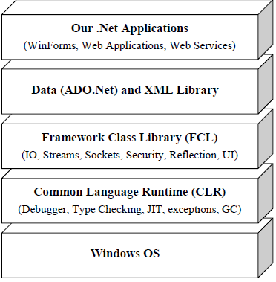

Slide 4
Common Language Runtime(CLR)
It is the foundation of the .NET framework.
It is the responsibility of the runtime to take care the code execution of the program.
It is a framework layer that resides above the OS and handles the execution of all the .Net applications.
Programs don’t directly communicate with the OS but go through the CLR.
It manages memory, thread execution, code execution, code safety verification, compilation, and other system services.

Slide 5
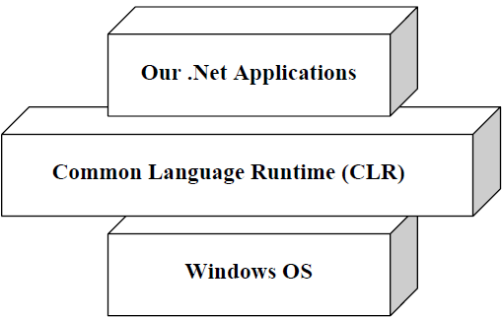
Contd…

Slide 6
Common Type System(CTS)
CTS define how types are declared, used and managed in the CLR,
It is also an important part of the runtime's support for cross-language integration.
The common type system performs the following functions:
Establishes a framework that helps enable cross-language integration, type safety, and high-performance code execution.
Provides an object-oriented model that supports the complete implementation of many programming languages.

Slide 7
Contd…
Defines rules that languages must follow, which ensures that objects written in different languages can interact with each other.
Provides a library that contains the primitive data types (such as Boolean, Byte, Char, Int32, and UInt64) used in application development.
A type is a representation of data(such as int).
All types in the .NET Framework are either value types or reference types.
Value types are data types whose objects are represented by the object's actual value.

Slide 8
Contd…
Reference types are data types whose objects are represented by a reference (similar to a pointer) to the object's actual value.

Slide 9
Common Language Specification
CLS is a set of basic language features that .Net Languages needed to develop Applications and Services.
It is a subset of the CTS.
The CLS establishes the minimum set of rules to promote language interoperability.
Microsoft has defined CLS, which are nothing but guidelines, that language should follow so that it can communicate with other .NET languages in a seamless manner.

Slide 10
The Framework Class Library(FCL) or Base class Library(BCL)
The .Net Framework class library (FCL) provides the core functionality of .Net Framework architecture.
The .Net Framework Class Library (FCL) includes a huge collection of reusable classes, interfaces, and value types that ease and optimize the development process and provide access to system functionality.
The .Net Framework provides a huge Framework(or Base) Class Library for common, usual tasks.
BCL contains thousands of classes to provide access to Common Data Structures, IO, Stream, Thread, Security, Network Programming, Windows Programming, Web Programming, Data Access, etc.

Slide 11
Contd…
It is simply the largest standard library ever shipped with any development environment or programming language.

Slide 12
Microsoft Intermediate Language
When All .NET source code compile it is converted to an intermediate code known as MSIL which is interpreted by the CLR.
MSIL is OS and hardware independent code.
This MSIL is converted to binary executable code(native code) at the point where the software is installed, or at run time by Just-In-Time(JIT compiler).

Slide 13


Slide 14
Just-In-Time compilers(JITers)
When IL compiled code needs to be executed, the CLR invokes the JIT compiler
which compile the IL code to native executable code(.exe or .dll) that is designed for specific machine and OS.
JITers compile the IL to native code only when desired.
Eg when a function is called, the IL of the function’s body is converted to native code just in time.
If some IL code is converted to native code, then the next time it’s needed, the CLR reuses the same copy without re-compiling.

Slide 15
Contd…
As JITers are aware of the specific processor and OS at runtime
They can optimize the code efficiently resulting in very robust applications.
Also, since a JIT compiler knows the exact current state of executable code, they can also optimize the code by in-lining small function calls.

Slide 16
Garbage Collection
CLR automatically manages memory thus eliminating memory leaks.
When any variable and reference are not referred, GC automatically releases those memories and dynamically allocated memory space thus providing efficient memory management.
The presence of a standard Garbage Collector frees the programmer from keeping track of dangling data.
Garbage collection does not happen immediately after an object. It happens periodically, although not to a fixed schedule
It is the advantage over C++ language.

Slide 17
Managed Code
Managed code runs inside the environment of CLR i.e. .NET runtime.
In short, all IL are managed code.
However, if you are using some third party software example VB6 or VC++ component they are unmanaged code, as .NET runtime (CLR) does not have control over the source code execution of these languages.
This means that the CLR looks after your application by managing memory, handling security, allowing cross language debugging, and so on.

Slide 18
Assemblies
An assembly is the basic unit of deployment in .NET and is also the container for all types.
An assembly contains compiled types with their IL code, runtime resources, and information to assist with versioning, security, and referencing other assemblies.
An assembly also defines a boundary for type resolution and security permissioning.
An assembly comprises a single Windows Portable Executable (PE) file—with an .exe extension
in the case of an application, or a .dll extension in the case of a reusable library.

Slide 19
Contd…
Assemblies also contain meta information which describes the program’s types, members, and attributes.
An assembly contains four kinds of things:
An assembly manifest:
Provides information to the .NET runtime, such as the assembly’s name, version, requested permissions, and other assemblies that it references
An application manifest:
Provides information to the operating system, such as how the assembly should be deployed and whether administrative elevation is required

Slide 20
Contd…
Compiled types:
The compiled IL code and metadata of the types defined within the assembly.
Resources:
Other data embedded within the assembly, such as images and localizable text Of these, only the assembly manifest is mandatory, although an assembly nearly always contains compiled types.

Slide 21
Windows Presentation Foundation(WPF)
WPF provides a unified programming model for building rich Windows smart client user experiences that incorporate UI, media, and documents.
WPF is a next-generation presentation system for building Windows client applications with visually stunning user experiences.
With WPF, we can create a wide range of both standalone and browser-hosted applications.
The core of WPF is a resolution-independent and vector-based rendering engine that is built to take advantage of modern graphics hardware.

Slide 22
The benefits of WPF over its predecessor, Windows Forms
It supports sophisticated graphics, such as arbitrary transformations, 3D rendering, and true transparency.
Its primary measurement unit is not pixel-based, so applications display correctly at any DPI (dots per inch) setting.
It has extensive dynamic layout support, which means you can localize an application without danger of elements overlapping.
Rendering uses DirectX and is fast, taking good advantage of graphics hardware acceleration.
User interfaces can be described declaratively in XAML files that can be maintained independently of the “code-behind” files—this helps to separate appearance from functionality.

Slide 23
Windows Communication Foundation (WCF)
It is a sophisticated communications infrastructure for building service-oriented applications.
The WCF client uses Simple Object Access Protocol (SOAP) to communicate with the server. Using WCF, we can send data as asynchronous messages from one service endpoint to another.
A service endpoint can be part of a continuously available service hosted by IIS.
An endpoint can be a client of a service that requests data from a service endpoint.
The messages can be as simple as a single character or word sent as XML, or as complex as a stream of binary data.

Slide 24
Contd…
A few sample scenarios include:
A secure service to process business transactions.
A service that supplies current data to others, such as a traffic report or other monitoring service.
A chat service that allows two people to communicate or exchange data in real time.
A dashboard application that polls one or more services for data and presents it in a logical presentation.

Slide 25
CONTD…
WCF is designed to offer a manageable approach to creating Web services and Web service clients.
One of the benefits of this decoupling is that clients have no dependency on the .NET platform or on any proprietary communication protocols.

